Slide 1
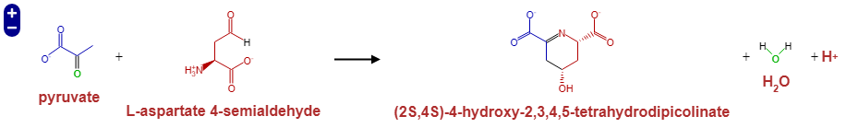
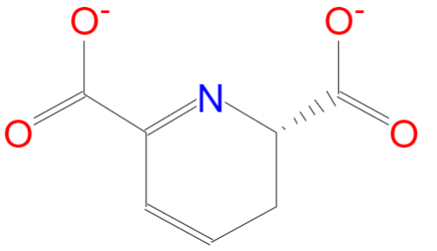
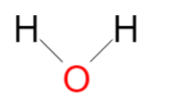
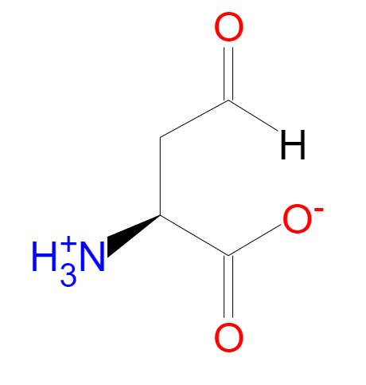
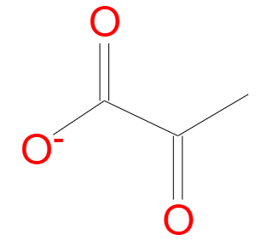
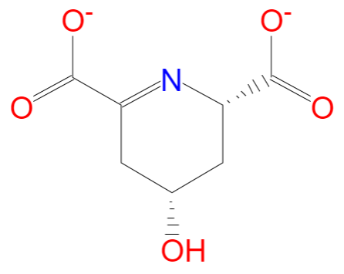
+
+
H⁺
+
DHDPS enzyme
(S)-2,3-dihydrodipicolinate
Pyruvate
L-aspartate 4-semialdehyde
+
+
H⁺
(2S,4S)-4-hydroxy-2,3,4,5-tetrahydrodipicolinate

